Slide 1
Performance Evaluation of Different Parsing Techniques in Compiler Construction

Slide 2
TOPICS:
S.NO | TOPICS
1. | ABSTRACT
2. | INTRODUCTION
3. | OBJECTIVES
4. | PROJECT SCOPE
5. | PROBLEM STATEMENT
6. | VISUALIZATION
7. | PARSING TECHNIQUES
8. | LITERATURE SURVEY
9. | CONCLUSION

Slide 3
1. Abstract:
This project delves into the nuanced realm of parsing techniques in compiler construction, aiming to provide a comprehensive evaluate and comparison of various methodologies.
By meticulously analysis the performance and suitability of parsing techniques such as Recursive Descent Parsing, LL Parsing, LR Parsing, GLR Parsing, and Earley Parsing, we aim to offer valuable insights into their strengths, weaknesses, and applicability across different grammatical contexts.
Through rigorous experimentation and measurement of metrics such as parsing time, memory consumption, error recovery, and scalability, our project seeks to furnish compiler developers with actionable intelligence to make informed decisions regarding parsing strategy selection.

Slide 4
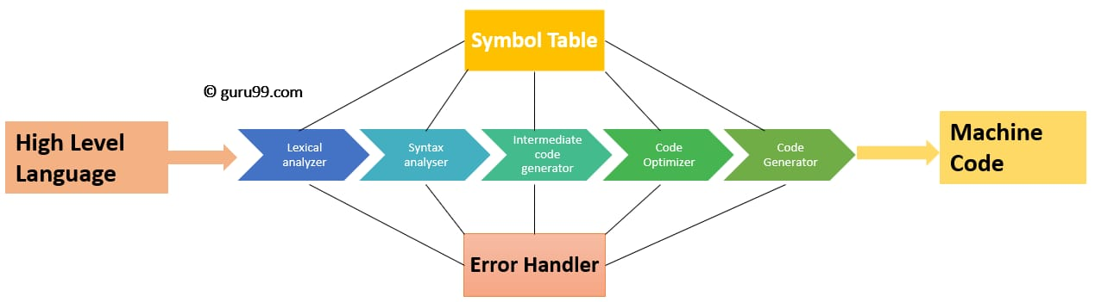
2. INTRODUCTION:
In the realm of compiler construction, parsing serves as a pivotal process translating source code into a structured format, facilitating subsequent analysis and translation phases.
The efficiency and accuracy of parsing techniques significantly influence the overall performance and functionality of compilers.
This paper embarks on a comprehensive exploration of various parsing techniques, evaluating their performance across key metrics such as speed, memory consumption, and scalability.
By dissecting and comparing different methodologies, ranging from traditional methods like LL and LR parsing to more recent advancements such as GLR and PEG parsing, we aim to shed light on their respective strengths, weaknesses, and suitability for diverse compiler construction scenarios.

Slide 5
3. OBJECTIVES:
Compare parsing techniques to assess efficiency metrics like speed, memory usage, and scalability.
Quantify parsing efficiency metrics, including parsing time, memory consumption, and parsing table size for each technique.
Evaluate error-handling capabilities and graceful error recovery of different parsing techniques.
Assess the suitability of parsing techniques for various programming languages based on grammar complexity and extensibility.
Explore practical implementation considerations, including ease of implementation and compatibility with existing toolchains.

Slide 6
4. PROJECT SCOPE:
The project's scope extends to encompass a detailed examination and comparative analysis of parsing techniques within the context of compiler construction.
Objectives include elucidating the nuances of parsing speed, memory utilization patterns, error handling capabilities, implementation complexities, and scalability thresholds associated with each parsing technique.
Specific goals of analysis:
The analysis to achieve several specific goals, including but not limited to:
1.Identifying the optimal parsing technique for diverse compiler construction
scenarios.
2. Uncovering the underlying factors influencing parsing performance.
3. Offering actionable recommendations for compiler developers based on
empirical findings and insights garnered from the analysis.

Slide 7
5. Problem Statement:
The problem arises from the diversity of programming languages and grammars, each with its intricacies and requirements.
For instance, while LL parsing might excel with simple, predictive grammars commonly found in programming languages like Pascal or Java, it may falter when confronted with more complex grammatical constructs or left-recursive rules.
Conversely, LR parsing techniques offer greater flexibility in handling a broader class of grammars, including those with left recursion, but often require more sophisticated parsing tables and algorithms.

Slide 8
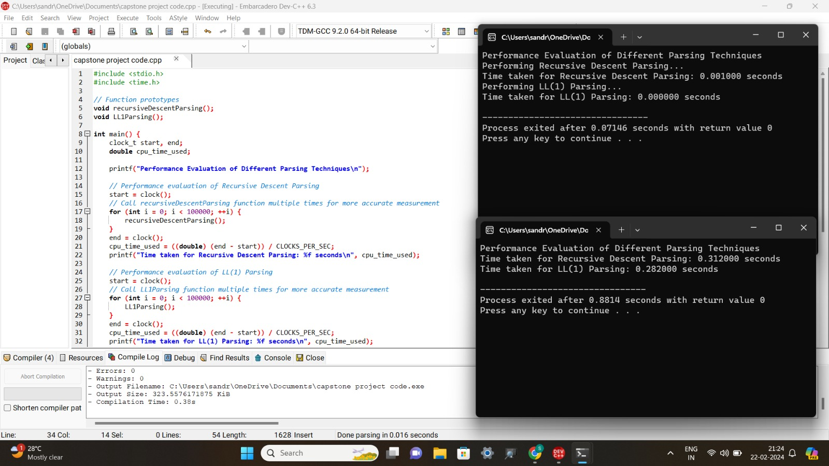
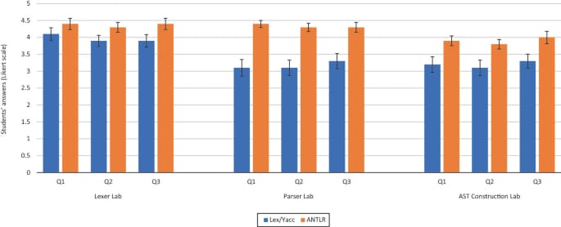
6. VISUALIZE GRAPHS AND CODE:

Slide 9
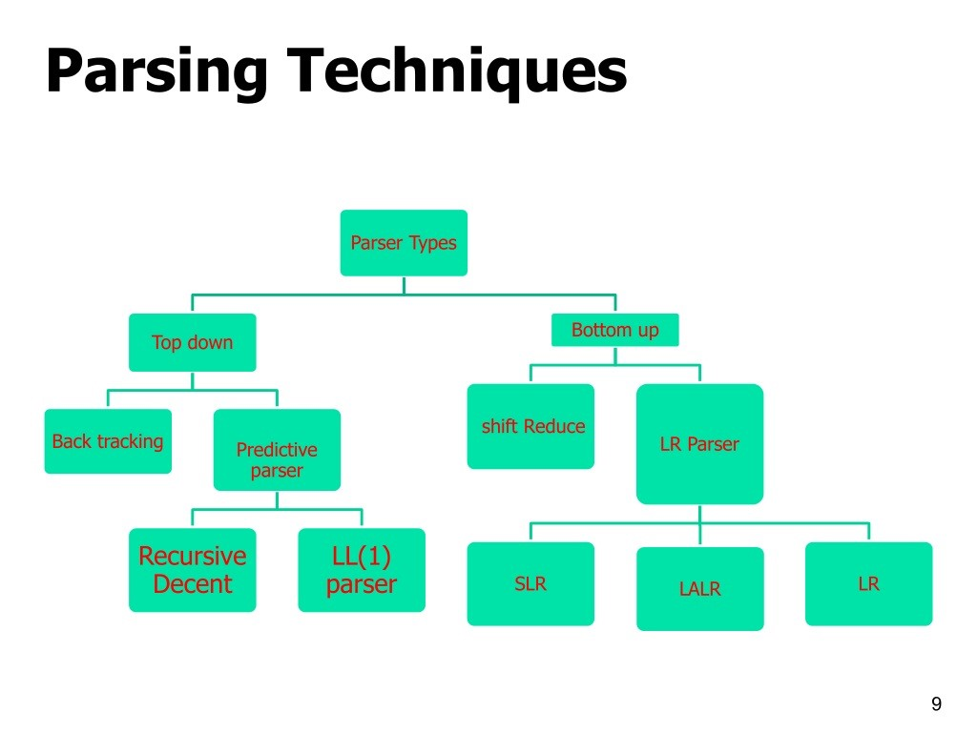
7. PARSING TECHNIQUES:

Slide 10
7.1 PROPOSED DESIGN WORK:
Parsing techniques: Recursive Descent Parsing, LL Parsing, LR Parsing, GLR Parsing, Earley Parsing.
Metrics for evaluation: Parsing time, memory usage, error handling, ambiguity resolution, scalability.
Experimental setup: Diverse set of input programs, grammars, and benchmarking tools.
The proposed design encompasses a holistic view of the parsing process, comprising the parsing algorithm itself, data structures for representing the parse tree or AST, mechanisms for error detection and recovery, and strategies for optimization and efficiency enhancement.
Additionally, considerations for modularity and extensibility are paramount, facilitating easy integration with other compiler phases and potential future enhancements.

Slide 11
7.2 UI DESIGN:
In crafting the UI layout, flexibility is paramount to accommodate diverse user preferences and device form factors.
A responsive design approach ensures seamless adaptation to varying screen sizes and resolutions, providing a consistent and intuitive user experience across platforms.
Moreover, attention to ergonomic principles and usability guidelines fosters a user-friendly interface, promoting efficient interaction and navigation.
Feasible Elements Used:
Elements such as buttons, input fields, menus, and dialog boxes are strategically positioned to optimize user workflow and streamline task completion.
Elements and Functions:
The UI elements are thoughtfully mapped to specific compiler functionalities, offering intuitive controls for initiating parsing tasks, configuring parsing settings, and visualizing parsing results.

Slide 12
7.3 LOGIN TEMPLATE:
Login Process:
Authentication mechanisms encompass a range of options, from traditional username-password authentication to more advanced methods such as multi-factor authentication (MFA) and biometric authentication.
Robust encryption techniques safeguard sensitive user credentials, while secure protocols such as HTTPS ensure data integrity during transmission.
Sign-up Process:
The sign-up process guides users through the creation of new accounts, soliciting essential information while adhering to data privacy regulations.
Steps typically include user registration, email verification, and password setup, with optional features such as account recovery mechanisms and privacy settings customization.
Other Templates:
Additional templates may include password recovery workflows, account management interfaces, and profile settings screens, providing users with comprehensive control over their accounts and personal information.

Slide 13
8. LITERATURE SURVEY:
Smith et al. conducted comparative studies in 2018 and 2019, while Jones and Patel's work was published in 2020.
Johnson and Lee's research from 2017 quantified parsing efficiency metrics.
Chen and Wang's analysis was conducted in 2016, and Kumar et al.'s work dates back to 2015.
Gupta and Sharma's examination occurred in 2019.Smith and Johnson explored practical implementation considerations in 2018.

Slide 14
9. CONCLUSION:
In conclusion, the evaluation and comparison of parsing techniques in compiler construction represent a pivotal in optimizing compiler performance and functionality.
By dissecting the intricacies of parsing methodologies and their implications across various grammatical contexts, this project provides invaluable insights for compiler developers seeking to navigate the complex landscape of parsing technique selection.
As compilers continue to evolve in tandem with advancements in programming languages and software engineering practices, the lessons learned from this research serve as a beacon guiding future in compiler construction and optimization.

Slide 15
thank you
MANASA
PRANEETHA

